Slide 1
Welcome Day 8 Child Counselling
Foundation Course

Slide 2
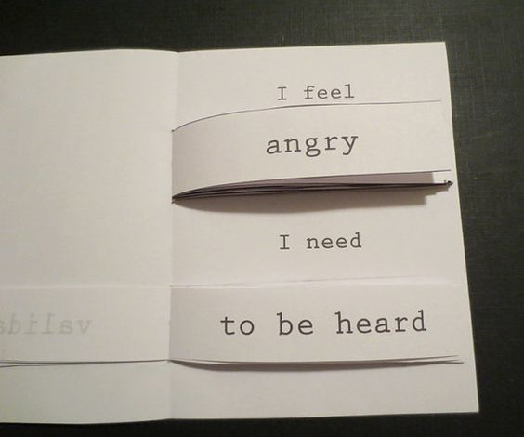
Today’s overview
I Need/I Feel Self Care Flipbook

Slide 3
Materials required
A4 sheets – 4
Markers
Scissors
Glue
Stapler

Slide 4
Instructions
I feel
I need
I can
STEPS
DOMAINS
List down core/dominant emotions. Help the child identify the same teaching them about emotions
Then write about the needs and probable healthy coping styles
Fold an A4 sheet to form a card
Cut strips of paper and write down the above
Pile them and stick them

Slide 5
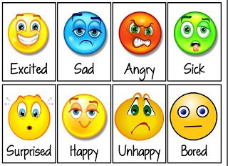

Slide 6
Applications:
Easy feedback for self
Easy feedback for parents
Access to healthy coping options

Slide 7
Child Counselling Advance LEVEL UP YOUR SKILLS
BY UK CERTIFIED THERAPIST
Click here for course structure and other details
Special discounts for winners of Foundation Child Counselling
contact 9875571412 | 98748 26177

Slide 8
If you like what we are doing . . .…
Help us spread the word by sharing this document
Follow us on any of our platforms
And keep supporting and loving us
It would motivate us to work harder
And come with more cool stuff!

Slide 9
Upcoming Courses
Advanced Child Counselling Certificate Course (Click for details)
Coming soon…
Art Therapy Diploma (coming soon…) – Duration 1 year
Colours: In Counselling & Healing Certificate (Coming soon) – 3 weeks
Anger Management (Coming soon) – 2 weeks
Anxiety Management (Coming soon) – 2 weeks
Understanding Disorders – 4 weeks
Deep Dive – Childhood Disorders – 4 weeks
Art Analysis – 4 weeks
Advanced Certificate in Counselling
Essentials of Counselling Certificate – only for students FREE internship! – 4 weeks
Foundation of Counselling Certificate – for professionals FREE – 2 weeks
TAT First Card Analysis in Counselling FREE
FOLLOW
any of our social media to keep updated!

Slide 10
Follow us on:
Facebook: https://www.facebook.com/emotionjar
Instagram: emo.jar (https://www.instagram.com/emo.jar/)
Youtube: https://www.youtube.com/channel/UCVNN0apG9sIccwEFY6YkmTA

Slide 11
Keep your self updated with upcoming workshops and events on www.emotionjar.com
Shoot us a mail at info@emotionjar.com
Call: 9875571412 | 9874826177

